Slide 1
WEEK 2
Data Cleaning I
Production-ready data cleaning skills for AI and ML pipelines
Day 6
Missing Values
Detection, quantification, basic handling strategies
Day 7
Imputation Strategies
Column-specific rules, indicators, train/test leakage
Day 8
Duplicate Records
Entity vs event, deduplication, aggregation
Day 9
Data Types
Numeric, datetime, mixed-type, schema stability
Day 10
Outliers & Ethics
IQR, z-score, capping, transformation, fairness
Tooling
pandas for table operations, numpy for numerical work
isna, dropna, fillna, duplicated, drop_duplicates, to_numeric, to_datetime, clip, np.log1p
import pandas as pd
import numpy as np
np.random.seed(42)

Slide 2
DAY 6
Missing Values
Detection, Quantification, and Basic Handling
OBJECTIVES
ACTIVITY
• Interpret different causes of missingness
• Detect and summarize with isna/isnull
• Decide when to drop rows/columns vs impute
• Use mean/median/mode/constant imputation
• Create missingness indicators
Analyze a partially observed behavioral dataset.
Compare 'drop rows' vs 'impute + indicator' pipelines.
ASSESSMENT
Justify strategy on a concrete feature.
Produce missingness summary and imputations.
Week 2 · Data Cleaning I

Slide 3
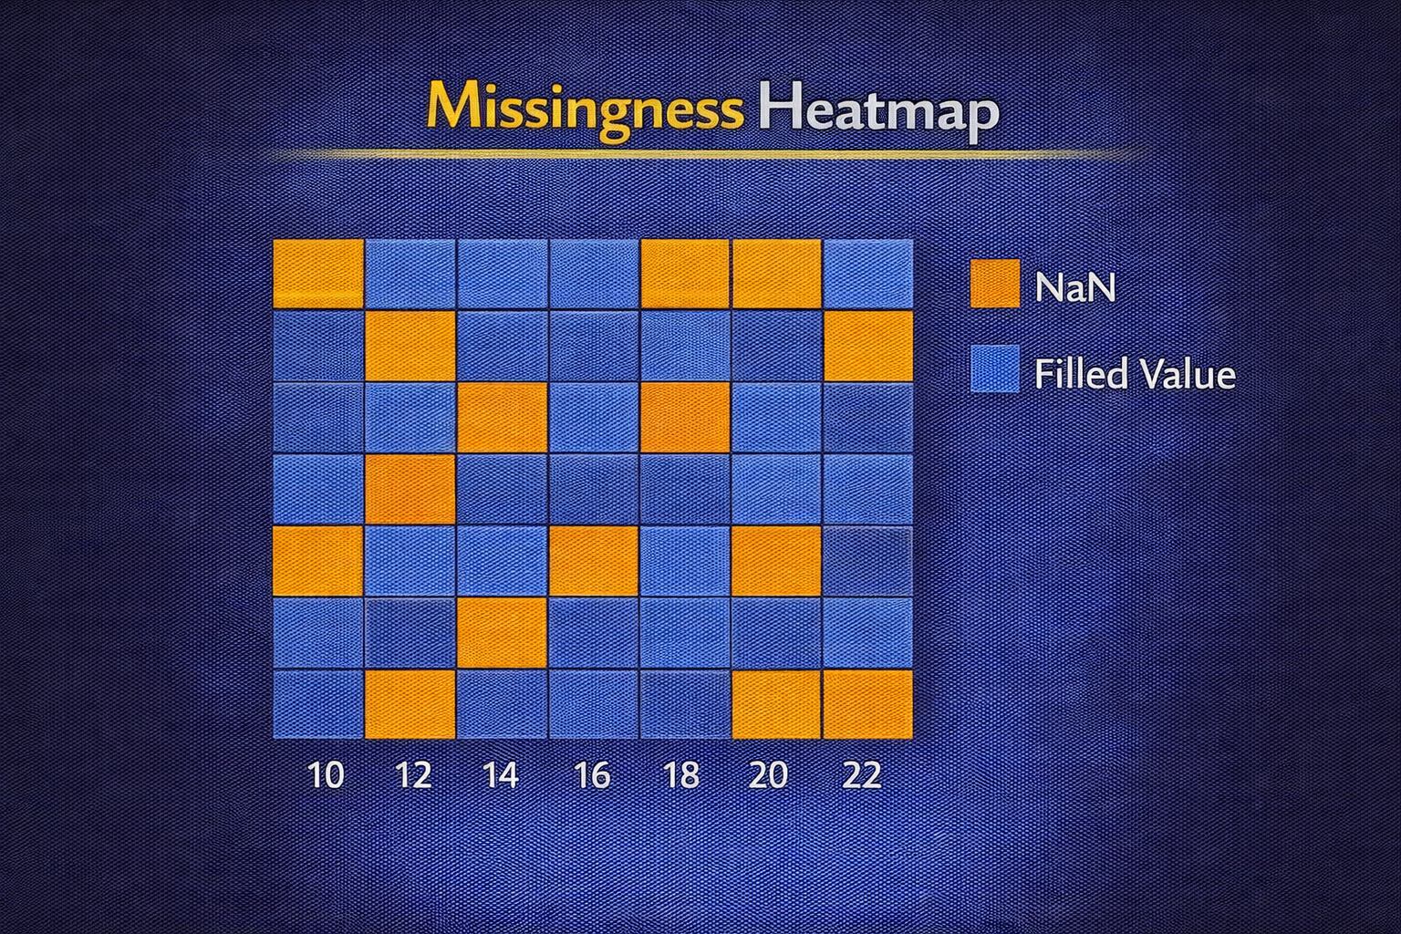
DAY 6 · MISSING VALUES
What Missing Values Represent
Missing values encode multiple real-world situations
Typical Meanings
Statistical Impact
• Never collected (sensor offline, survey skipped)
• Not applicable (field doesn't logically apply)
• Withheld (privacy, 'prefer not to say')
• Mis-encoded ('N/A', 'not reported', -999)
• Non-random missingness biases means, variances, correlations
• Sentinel values used as numbers can dominate averages and regression coefficients
CONSTRUCTING DIFFERENT MISSING PATTERNS
df_missing = pd.DataFrame({
"user_id": [1, 2, 3, 4, 5, 6],
"income_reported": ["55000", "62000", "N/A", "not reported", None, "0"],
"pregnancy_weeks": [None, None, 20, 32, None, 0], # Not applicable vs real
"age": [25, 30, np.nan, 40, 35, 28]
})

Slide 4
DAY 6 · MISSING VALUES
ML Impact of Missing Values
Treating all missing values the same is dangerous
Linear & Neural Models
Tree Models
• Treat sentinel values (like -999) as extreme magnitudes
• Can dramatically skew predictions
• May learn spurious patterns from encoding
• Can split strongly on sentinel values
• Risk overfitting to 'missing' as a category
• May seem robust but still affected
Key Insight
Before cleaning, ask what each missing pattern means in the domain. Different causes require different handling strategies.

Slide 5
DAY 6 · MISSING VALUES
Detecting Missing Values
Built-ins and custom tokens
Core Functions
Custom Tokens
• df.isna() / df.isnull() for element-wise masks
• df.isna().sum() for per-column counts
• df.isna().mean() for per-column percentages
• Pandas only flags NaN, None, NaT as missing
• Domain strings like 'N/A', 'unknown', '?' must be normalized to NaN early
• Risk: over-normalizing erases rare real categories
NORMALIZE TOKENS THEN INSPECT
custom_missing = ["N/A", "NA", "not reported", "unknown", "?"]
df_norm = df_missing.copy()
df_norm["income_reported"] = df_norm["income_reported"].replace(custom_missing, np.nan)
print(df_norm)
print("\nMissing per column:\n", df_norm.isna().sum())

Slide 6
DAY 6 · MISSING VALUES
Quantifying Missingness
Counts and percentages clarify which columns/rows are problematic
Useful Summaries
Decision Use
• Per-column missing count and percentage
• Per-row missing count (record completeness)
• Group-level missingness (by segment/region)
• Identify columns to drop or needs advanced imputation
• Identify subgroups with systematically poorer data collection
COMPACT MISSINGNESS SUMMARY
def missing_summary(df: pd.DataFrame) -> pd.DataFrame:
total = df.isna().sum()
pct = (df.isna().mean() * 100).round(1)
return (pd.DataFrame({"missing_count": total, "missing_percent": pct})
.sort_values("missing_percent", ascending=False))
summary = missing_summary(df_norm)
df_norm["missing_per_row"] = df_norm.isna().sum(axis=1)

Slide 7
DAY 6 · MISSING VALUES
Dropping Rows vs Dropping Columns
Easy but blunt - must be justified
When to Drop Rows
When to Drop Columns
• Missingness is rare and spread across rows
• Critical labels/predictors are missing and cannot be reliably imputed
Risk: Shrinks dataset, introduces selection bias
• Column is mostly missing and not business-critical
• Cannot construct trustworthy imputation
Risk: May discard predictive or fairness-relevant info
BASIC DROPPING PATTERNS
critical_cols = ["income_reported", "age"]
df_drop_any = df_norm.dropna(how="any") # Drop if ANY column missing
df_drop_crit = df_norm.dropna(subset=critical_cols) # Drop only if critical cols missing
print("Original:", df_norm.shape, "Drop any:", df_drop_any.shape, "Drop critical:", df_drop_crit.shape)

Slide 8
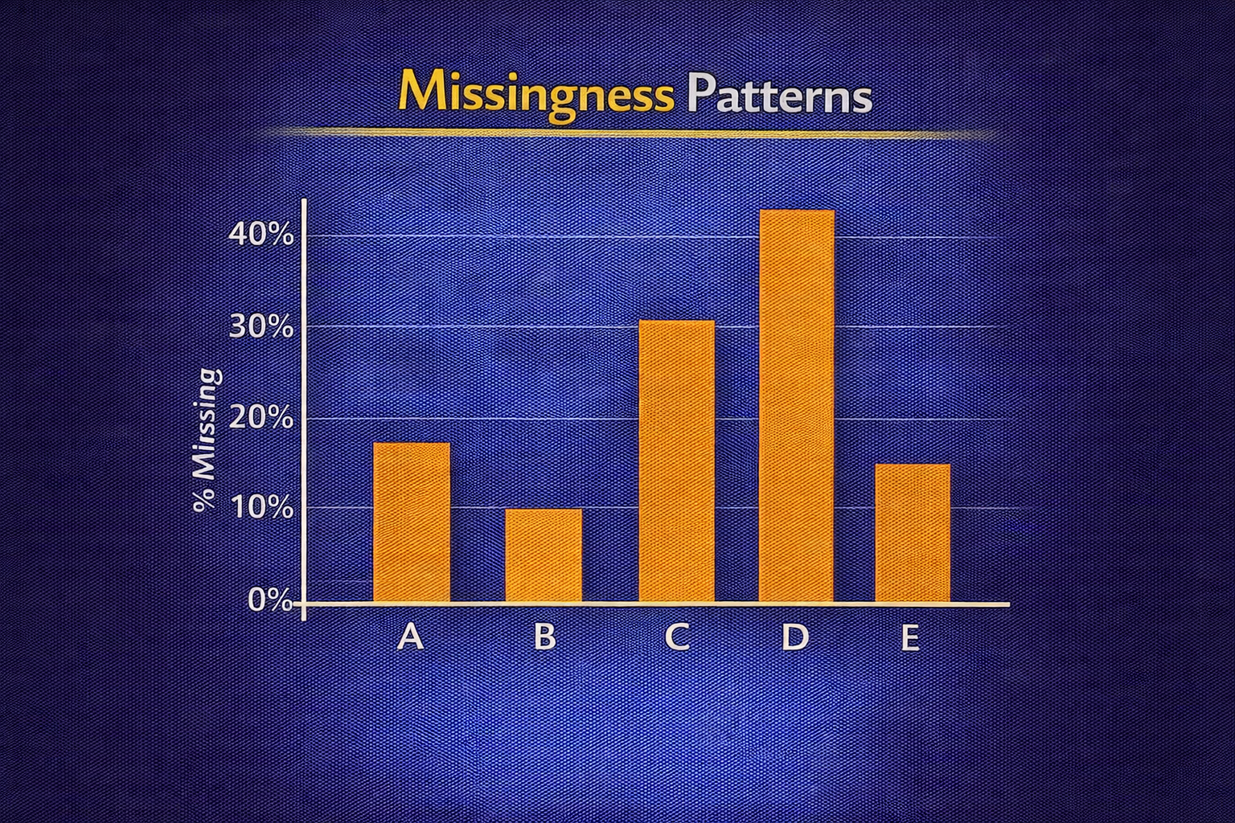
DAY 6 · MISSING VALUES
Basic Imputation — Mean, Median, Mode
Replace missing with estimates from observed data
Mean
Median
Mode
• Best for symmetric numeric features
• Reduces variance
• Sensitive to outliers
• Robust for skewed distributions
• Better for income, prices
• Preserves center better
• For categorical features
• Inflates dominant category
• May hide missingness info
NUMERIC MEAN/MEDIAN, CATEGORICAL MODE
df_imp = df_norm.copy()
df_imp["income_num"] = pd.to_numeric(df_imp["income_reported"], errors="coerce")
df_imp["age_mean_imp"] = df_imp["age"].fillna(df_imp["age"].mean())
df_imp["age_median_imp"] = df_imp["age"].fillna(df_imp["age"].median())
mode_income = df_imp["income_reported"].mode(dropna=True)[0]
df_imp["income_mode_imp"] = df_imp["income_reported"].fillna(mode_income)

Slide 9
DAY 6 · MISSING VALUES
Constant Imputation + Missingness Indicator
Preserve information that value was originally missing
When to Use Constant
Why Add Indicator
• Features where constant reflects meaningful 'none' state
• When combining with binary indicator column
• Common constants: 0, -1, 'Unknown'
• Preserves info that value was missing
• Allows model to distinguish 'real 0' from 'imputed 0'
• Missingness itself may be predictive
CONSTANT + INDICATOR FOR NUMERIC AND CATEGORICAL
df_const = df_imp.copy()
df_const["age_missing"] = df_const["age"].isna().astype(int) # 1 if was missing
df_const["age_const"] = df_const["age"].fillna(-1) # Fill with sentinel
df_const["income_missing"] = df_const["income_reported"].isna().astype(int)
df_const["income_const"] = df_const["income_reported"].fillna("Unknown")

Slide 10
DAY 6 · MISSING VALUES
ML Impact of Missingness and Imputation
Think of imputation as part of model design
Effects on Models
Fairness Considerations
• Changing means/variances → different linear coefficients
• Changing category frequencies → different priors/thresholds
• Indicators allow exploiting data-collection patterns
• If missingness concentrated in specific groups, naive imputation misrepresents them
• Dropping incomplete rows may systematically exclude certain users
TOY COMPARISON: MEAN VS MEDIAN IN REGRESSION
from sklearn.linear_model import LinearRegression
X_mean = df_model["age"].fillna(age_mean).to_frame()
X_median = df_model["age"].fillna(age_median).to_frame()
y = df_model["clicked_ad"].values
coef_mean = LinearRegression().fit(X_mean, y).coef_[0]
coef_median = LinearRegression().fit(X_median, y).coef_[0]

Slide 11
DAY 6 · ACTIVITY & ASSESSMENT
Missing Values Practice
Build and compare cleaning pipelines
Activity Steps
Assessment
1. Load partially observed user dataset
2. Normalize custom missing tokens to NaN
3. Produce missingness summary (per-column %, per-row)
4. Build Version A: drop rows with missing in key cols
5. Build Version B: impute + indicators
6. Train classifier on A and B; compare metrics
Written: Explain when you would prefer dropping rows over imputation on a churn dataset.
Coding: Implement a function that drops columns with missing_percent > 0.7 and justify the threshold.
SKELETON
df_raw = pd.read_csv("user_data.csv")
df_raw = df_raw.replace(["N/A", "NA", "not reported", "unknown", "?"], np.nan)
summary = missing_summary(df_raw)

Slide 12
DAY 7
Imputation Strategies
Column-Specific Rules and Avoiding Leakage
OBJECTIVES
ACTIVITY
• Explain why imputation is never neutral
• Choose strategies based on feature type/distribution
• Implement column-wise rules with indicators
• Apply imputation in train/test-safe way
• Avoid data leakage from future information
Build imputation function that learns on train, applies to test.
ASSESSMENT
Conceptual: leakage scenarios and impact.
Coding: reusable imputation utilities.
Week 2 · Data Cleaning I

Slide 13
DAY 7 · IMPUTATION
Why Imputation Is Not Neutral
Imputation assumes something about unobserved data
Distribution Changes
Model Effects
• Mean/median imputation shrinks variance
• Mode/constant creates artificial spikes
• Correlations artificially strengthened/weakened
• Linear models see reduced spread, altered coefficients
• Tree models see clusters at imputation constants
• Neural networks may learn imputation artifacts
VARIANCE COMPARISON BEFORE/AFTER IMPUTATION
df_demo = df_imp.copy()
print("Age with NaN:\n", df_demo["age"].describe())
df_demo["age_mean_imp"] = df_demo["age"].fillna(df_demo["age"].mean())
print("\nAge after mean imputation:\n", df_demo["age_mean_imp"].describe()) # Note: std decreases

Slide 14
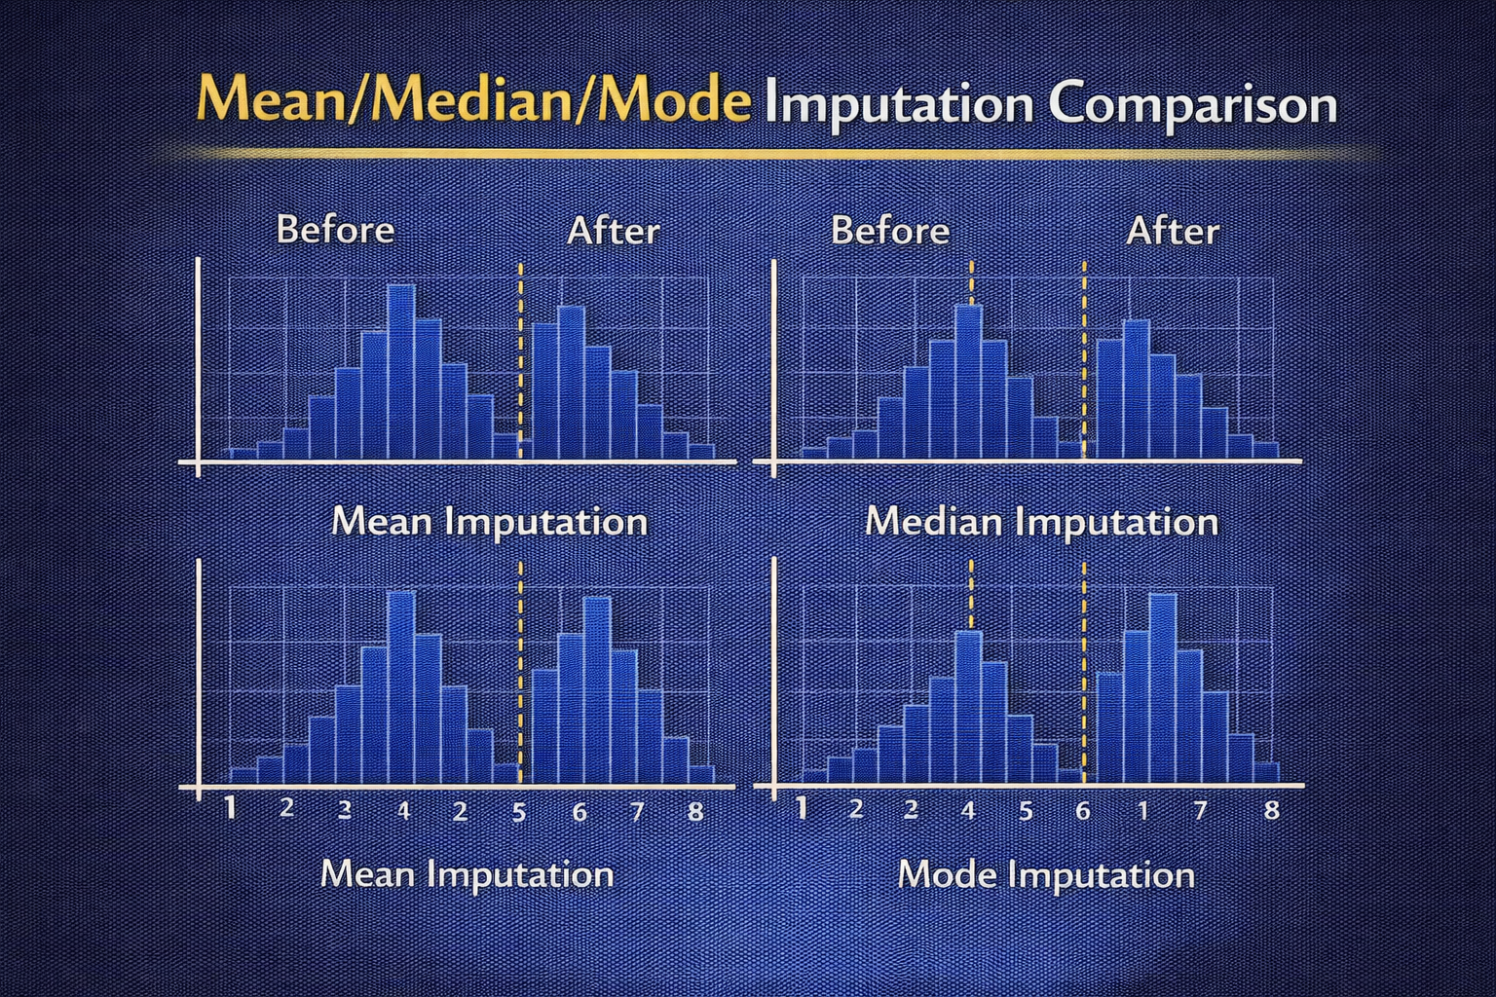
DAY 7 · IMPUTATION
Column-Specific Strategies
Different features warrant different imputation rules
Guidelines
Risks
• Symmetric numeric → mean
• Skewed numeric → median
• Nominal categorical → mode or 'Unknown'
• Ordinal categorical → median or mode
• Using mean on heavy-tailed features biases estimates
• Inconsistent strategies across features hinder interpretation
• Document all choices!
COLUMN-WISE RULE APPLICATION
strategies = {"age": ("median", None), "income_num": ("median", None),
"income_reported": ("constant", "Unknown")}
for col, (kind, val) in strategies.items():
if kind == "mean": df_cs[col + "_imp"] = df_cs[col].fillna(df_cs[col].mean())
elif kind == "median": df_cs[col + "_imp"] = df_cs[col].fillna(df_cs[col].median())
elif kind == "constant": df_cs[col + "_imp"] = df_cs[col].fillna(val)

Slide 15
DAY 7 · IMPUTATION
Distribution-Aware Imputation
Mean vs Median guided by empirical distribution
Steps
Example: Income
1. Inspect summary stats (mean, median, quantiles)
2. Check for outliers and skewness
3. Prefer median when tails are long (income, prices)
4. Document the reasoning
• Income is typically right-skewed
• Mean pulled up by high earners
• Median more representative of 'typical' user
INCOME EXAMPLE
mean_inc = df_dist["income_num"].mean()
median_inc = df_dist["income_num"].median()
df_dist["income_mean_imp"] = df_dist["income_num"].fillna(mean_inc)
df_dist["income_median_imp"] = df_dist["income_num"].fillna(median_inc)
print("Mean:", mean_inc, "Median:", median_inc) # Median typically lower for skewed data

Slide 16
DAY 7 · IMPUTATION
Categorical Imputation — Mode vs Special Category
Balance simplicity and clarity about missingness
Mode
Special Category ('Unknown')
• Simple, uses existing categories
• Increases dominance of majority category
• Hides that value was missing
• Makes missingness explicit in feature space
• Can capture users who systematically avoid answering
• May be predictive signal itself
MODE VS 'UNKNOWN'
mode_inc = df_cat["income_reported"].mode(dropna=True)[0]
df_cat["income_mode"] = df_cat["income_reported"].fillna(mode_inc)
df_cat["income_unknown"] = df_cat["income_reported"].fillna("Unknown")
print(df_cat[["income_reported", "income_mode", "income_unknown"]])

Slide 17
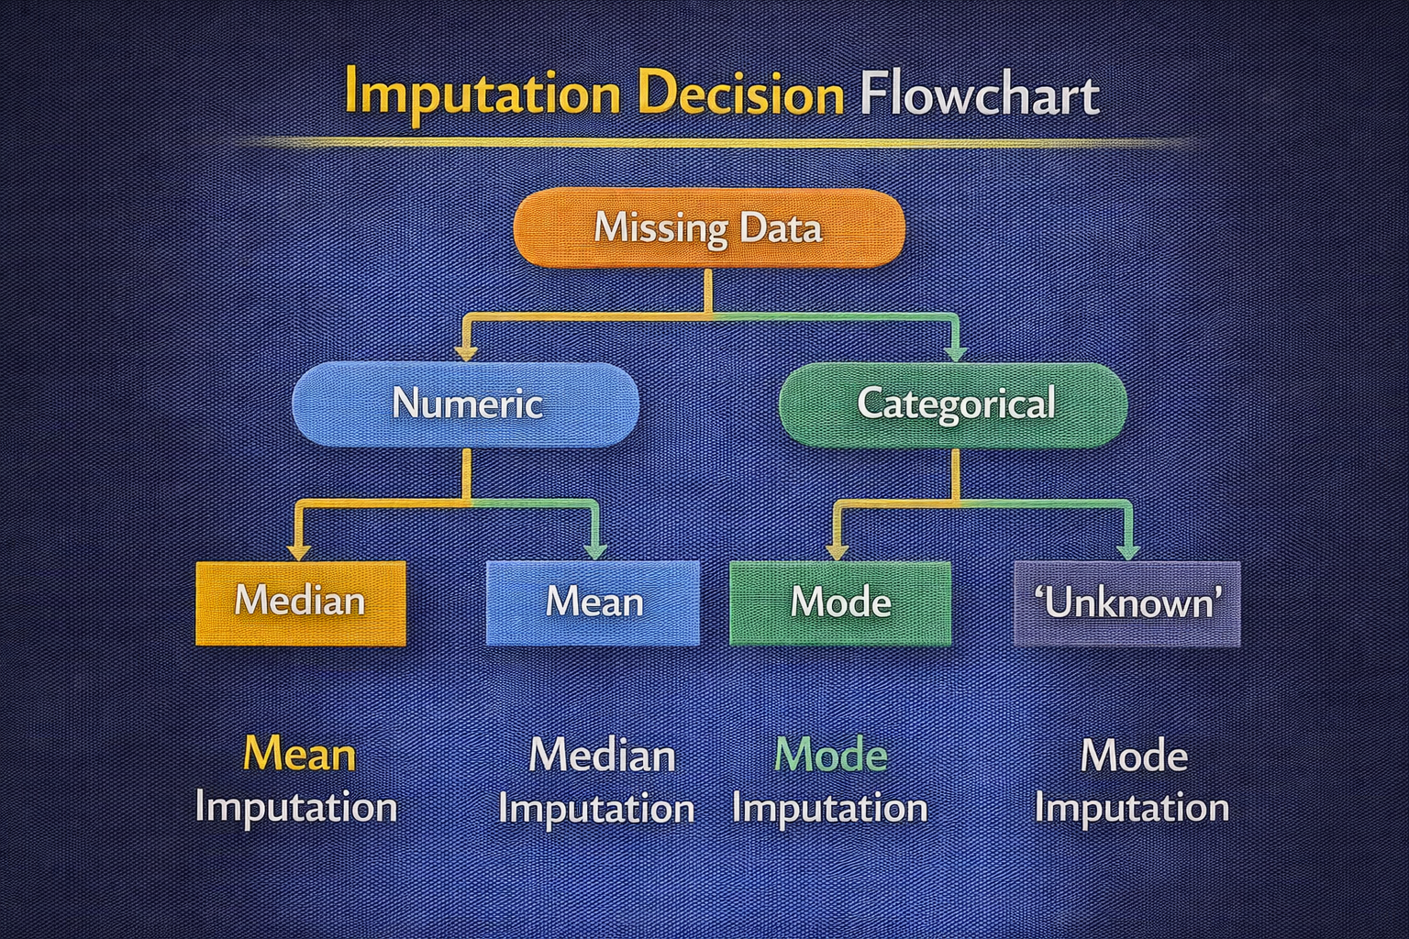
DAY 7 · IMPUTATION
Missingness Indicators and Model Behavior
Compact features marking originally missing values
Benefits
Risks
• Preserve info that imputation would erase
• Useful when missingness related to outcome
• Models can learn from data-collection patterns
• May overfit to data-collection quirks
• Indicators may pick up group-level differences
• Can increase model complexity
ADD INDICATORS AND IMPUTE
df_ind = df_imp.copy()
for col in ["age", "income_num"]:
df_ind[col + "_missing"] = df_ind[col].isna().astype(int) # Binary indicator
med = df_ind[col].median()
df_ind[col + "_imp"] = df_ind[col].fillna(med)
print(df_ind.head()) # Now has both imputed values and indicators

Slide 18
DAY 7 · IMPUTATION
Train/Test Separation and Data Leakage
Fit imputation parameters on train only
Correct Pattern
Leakage Effects
1. Split into train and test
2. Fit imputation parameters on train only
3. Apply those parameters to both train and test
4. Never peek at test during fitting
• Over-optimistic metrics (looks better than reality)
• Degraded production performance
• Future data is unknown at training time!
SAFE MEDIAN IMPUTATION
train_df, test_df = train_test_split(df_leak, test_size=0.4, random_state=42)
medians = {c: train_df[c].median() for c in ["age", "income_num"]} # Fit on train
def apply_imp(df, med):
out = df.copy()
for c, v in med.items(): out[c] = out[c].fillna(v) # Apply train params
return out

Slide 19
DAY 7 · ACTIVITY & ASSESSMENT
Imputation Practice
Build leakage-free imputation utilities
Activity
Assessment
1. Implement fit_imputer(train_df) that computes medians for numeric, modes for categorical
2. Implement transform_imputer(df, params) to apply learned rules
3. Train classifier with and without indicators
4. Compare behavior and metrics
Conceptual: Explain a realistic imputation-leakage scenario and its impact on a deployed model.
Coding: Write justification for using median over mean on a skewed feature in a credit-risk model.
SKELETON
def fit_imputer(train, num_cols, cat_cols):
return {"num_median": {c: train[c].median() for c in num_cols},
"cat_mode": {c: train[c].mode(dropna=True)[0] for c in cat_cols}}

Slide 20
DAY 8
Duplicate Records
Entity vs Event and Aggregation Strategies
OBJECTIVES
ACTIVITY
• Distinguish entity vs event duplicates
• Use duplicated and drop_duplicates with subsets
• Design deduplication rules with business logic
• Recognize leakage and bias risks
• Aggregate events to entity-level features
Deduplicate and aggregate an event log dataset.
ASSESSMENT
Conceptual questions plus deduplication coding task.
Week 2 · Data Cleaning I

Slide 21
DAY 8 · DUPLICATES
What Duplicates Actually Mean
Not all duplicates are errors
Entity Duplicates
Event Duplicates
Pipeline Duplicates
Multiple rows for same real-world entity (e.g., same customer)
Arises from: system merges, multiple registrations
Multiple logs of same event (e.g., retries, re-sends)
May be valid or artifacts
Re-ingested files, bad joins, concatenation mistakes
Almost always errors
INSPECT RAW DUPLICATES
df_dups = pd.DataFrame({
"user_id": [1, 1, 2, 2, 2, 3],
"event_time": ["2024-01-01 10:00:00", "2024-01-01 10:00:00",
"2024-01-02 11:00:00", "2024-01-02 11:05:00", "2024-01-02 11:05:00", "2024-01-03"],
"clicked_ad": [1, 1, 0, 0, 0, 1]
})

Slide 22
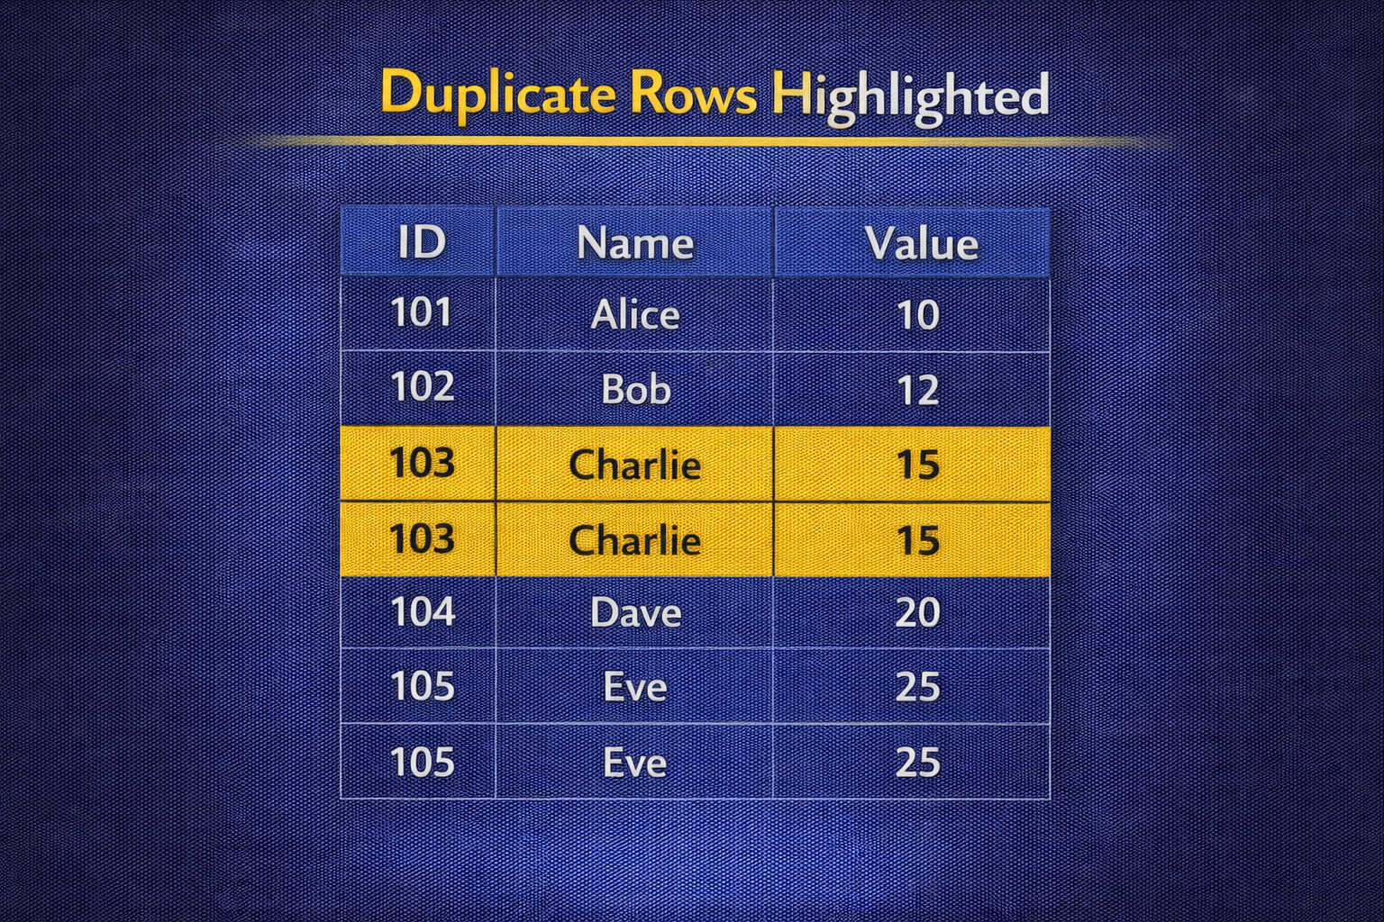
DAY 8 · DUPLICATES
Detecting Duplicates — Full-Row vs Subset-Based
The subset you choose encodes your uniqueness rule
Full-Row
Subset-Based
Use when duplicates are exact copies from ingestion errors
df.duplicated() checks all columns
Use when specific columns define uniqueness (user_id, event_time)
df.duplicated(subset=[...]) for business logic
SUBSET DUPLICATE DETECTION
mask_full = df_dups.duplicated() # All columns
mask_subset = df_dups.duplicated(subset=["user_id", "event_time"]) # Business keys
print("Full-row duplicates:\n", df_dups[mask_full])
print("\nSubset duplicates (user_id, event_time):\n", df_dups[mask_subset])

Slide 23
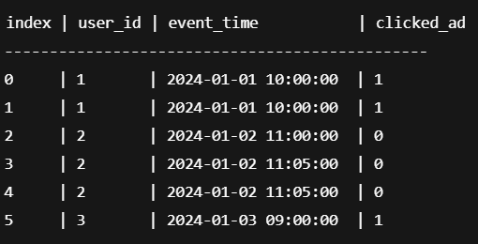
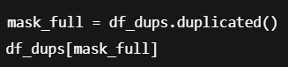

Slide 24
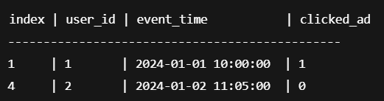

Slide 25
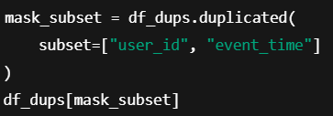

Slide 26
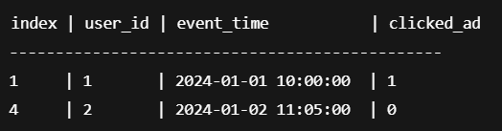

Slide 27
DAY 8 · DUPLICATES
Sorting Before Deduplication
Choosing which record represents the truth
Common Policies
Why Sort First
• Keep earliest event (first timestamp)
• Keep latest event (last timestamp)
• Keep best-quality record (fewest missing)
• Keep highest-value record
• Sorting determines which row is 'first' or 'last'
• Without sorting, order is arbitrary
• Explicit sorting makes logic reproducible
FIRST VS LAST BY TIME
df_sorted = df_dups.sort_values(["user_id", "event_time"])
keep_first = df_sorted.drop_duplicates(subset=["user_id", "event_time"], keep="first")
keep_last = df_sorted.drop_duplicates(subset=["user_id", "event_time"], keep="last")
print("Keep first:", len(keep_first), "Keep last:", len(keep_last))

Slide 28
DAY 8 · DUPLICATES
Valid vs Invalid Duplicates and Leakage
Some duplicates should be aggregated, not removed
Valid Duplicates
Leakage Risk
Repeated events that really happened (e.g., two purchases)
Should be aggregated to features, not deleted
If same user appears with near-identical features in both train and test, metrics inflate
Always check user overlap across splits!
CHECK USER OVERLAP ACROSS SPLITS
train_d, test_d = train_test_split(df_leak_dups, test_size=0.5, random_state=42)
overlap = set(train_d["user_id"]).intersection(test_d["user_id"])
print("User IDs in both train and test:", overlap) # Should be empty for entity prediction

Slide 29
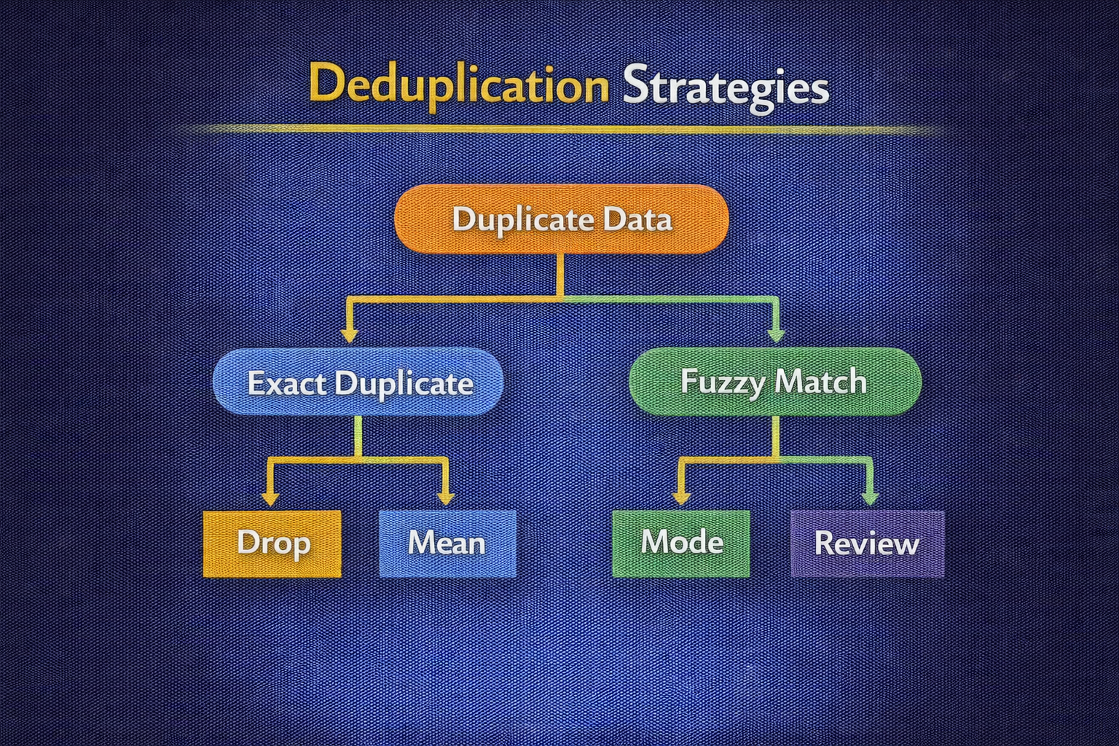
DAY 8 · DUPLICATES
Aggregation Instead of Row Removal
Build entity-level features from event logs
Typical Aggregates
ML Impact
• Event counts (total interactions)
• Days active, date ranges
• Max/min timestamps
• Any/ever outcomes ('ever clicked')
• Models operate on stable per-entity features
• Reduces noise from duplicate events
• More interpretable feature space
SIMPLE USER-LEVEL AGGREGATION
df_agg = (df_dups
.groupby("user_id")
.agg(
events=("event_time", "count"),
clicked_any=("clicked_ad", "max") # 1 if ever clicked
) .reset_index())
print(df_agg)

Slide 30
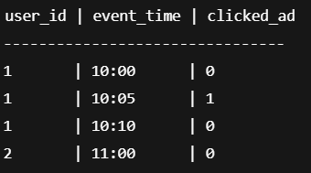
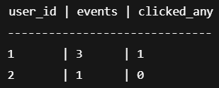
DAY 8 · DUPLICATES
Aggregation Instead of Row Removal
Build entity-level features from event logs
Typical Aggregates
ML Impact
• Event counts (total interactions)
• Days active, date ranges
• Max/min timestamps
• Any/ever outcomes ('ever clicked')
• Models operate on stable per-entity features
• Reduces noise from duplicate events
• More interpretable feature space
SIMPLE USER-LEVEL AGGREGATION
df_agg = (df_dups
.groupby("user_id")
.agg(
events=("event_time", "count"),
clicked_any=("clicked_ad", "max") # 1 if ever clicked
) .reset_index())
print(df_agg)

Slide 31
DAY 8 · ACTIVITY & ASSESSMENT
Duplicates Practice
Deduplicate and aggregate transaction data
Activity
Assessment
1. Start from transaction/clickstream dataset
2. Remove exact full-row duplicates
3. Define uniqueness rule (user, day, product)
4. Sort and apply drop_duplicates with subset
5. Aggregate to entity-level features
6. Compare model on raw events vs aggregated
Conceptual: Explain how event duplicates could inflate click-through rate metrics.
Coding: Implement per-user aggregation with event count and 'ever clicked' flags for a churn model.
SKELETON
def deduplicate_events(df, subset_cols, sort_cols, keep="last"):
df_sorted = df.sort_values(sort_cols)
return df_sorted.drop_duplicates(subset=subset_cols, keep=keep)

Slide 32
DAY 9
Data Types & Type Consistency
Schema Stability Across Training and Production
OBJECTIVES
ACTIVITY
• Inspect and understand pandas dtypes
• Convert numeric strings and currencies safely
• Handle mixed-type columns
• Parse datetimes and extract features
• Ensure schema stability in pipelines
Normalize a messy schema into a clean, typed feature table.
ASSESSMENT
Explain type mismatch impact on production.
Implement production-ready normalize_schema().
Week 2 · Data Cleaning I

Slide 33
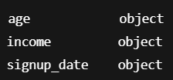
DAY 9 · DATA TYPES
Why Incorrect Types Break ML
String numerics and unparsed dates cause silent failures
Problems
Pipeline Risk
• Aggregations on string numerics concatenate instead of summing
• Mixed-type columns become 'object', hiding structure
• Broken datetime parsing → NaT and missing temporal features
• Downstream systems expect specific dtypes
• Mismatches cause crashes or subtle performance loss
• Training/production schema drift is common
TYPE INSPECTION
df_types = pd.DataFrame({"age": ["25", "30", "40"],
"income": ["$55,000", "$62,000", "not reported"],
"signup_date": ["2024-01-01", "01/03/2024", "2024-13-01"]})
print(df_types.dtypes) # All object! Need conversion

Slide 34
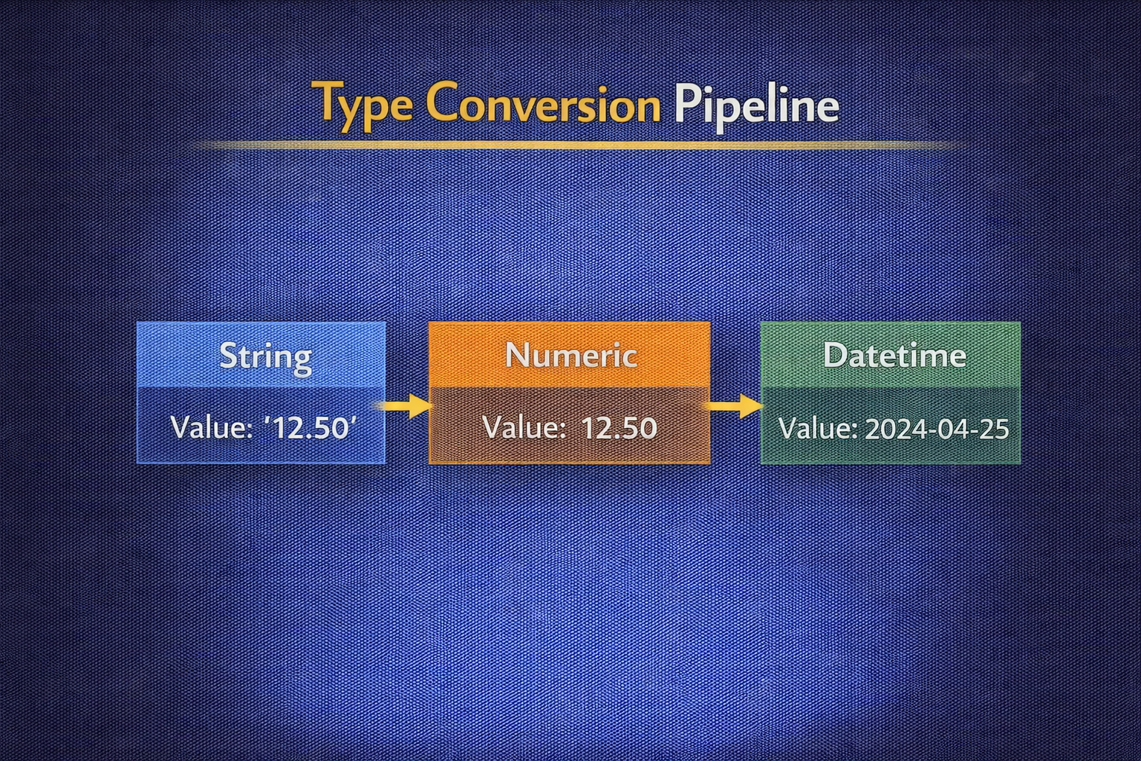
DAY 9 · DATA TYPES
Numeric Strings → Numbers
pd.to_numeric(errors='coerce') for robust conversion
Benefits
Post-Step
• Robust to messy entries like 'not reported', empty strings
• Unexpected tokens become NaN instead of throwing
• Downstream missing-value logic handles NaN
• Always inspect how many values became NaN
• Large NaN count may indicate wrong column identified as numeric
• Document conversions
SAFE NUMERIC CONVERSION
df_num = pd.DataFrame({"age_raw": ["25", "30", "not reported", "40", ""]})
df_num["age"] = pd.to_numeric(df_num["age_raw"], errors="coerce")
print(df_num)
print("\nMissing ages:", df_num["age"].isna().sum()) # 2 became NaN

Slide 35
DAY 9 · DATA TYPES
Currency Cleaning to Numeric
Strip symbols and commas before conversion
Steps
Common Issues
1. Remove non-numeric characters (keep . and -)
2. Convert with to_numeric(errors='coerce')
3. Treat failed parses as missing
4. Validate result ranges
• Mixed currency symbols ($, €, USD)
• Thousand separators (, vs .)
• Text mixed with numbers
• Negative values in parentheses
CURRENCY CLEANING FUNCTION
def clean_currency(s: pd.Series) -> pd.Series:
cleaned = s.str.replace(r"[^0-9.\-]", "", regex=True) # Keep digits, dot, minus
return pd.to_numeric(cleaned, errors="coerce")
df_curr["income_num"] = clean_currency(df_curr["income"])

Slide 36
def clean_currency(s: pd.Series) -> pd.Series:
cleaned = s.str.replace(r"[^0-9.\-]", "", regex=True) # Keep digits, dot, minus
return pd.to_numeric(cleaned, errors="coerce")
df_curr["income_num"] = clean_currency(df_curr["income"])
Original value | After replace | After to_numeric
"$1,200" | "1200" | 1200
"USD -50" | "-50" | -50
"1,234.56" | "1234.56" | 1234.56
"300" | "300" | 300
"not reported" | "" | NaN

Slide 37
DAY 9 · DATA TYPES
Mixed-Type Columns and Coercion
Normalize before modeling
Approach
Why Cast to String First
1. Cast to string first
2. Replace known tokens ('N/A', 'unknown') with NaN
3. Convert to numeric with errors='coerce'
4. Result: clean numeric or NaN
• Ensures consistent handling
• Avoids type errors on mixed columns
• Makes replacement reliable
MIXED-TYPE HANDLING
df_mixed = pd.DataFrame({"score": [10, "12", "N/A", 15, "unknown", 20]})
df_mixed["score_str"] = df_mixed["score"].astype(str)
df_mixed["score_str"] = df_mixed["score_str"].replace(["N/A", "unknown"], np.nan)
df_mixed["score_num"] = pd.to_numeric(df_mixed["score_str"], errors="coerce")

Slide 38
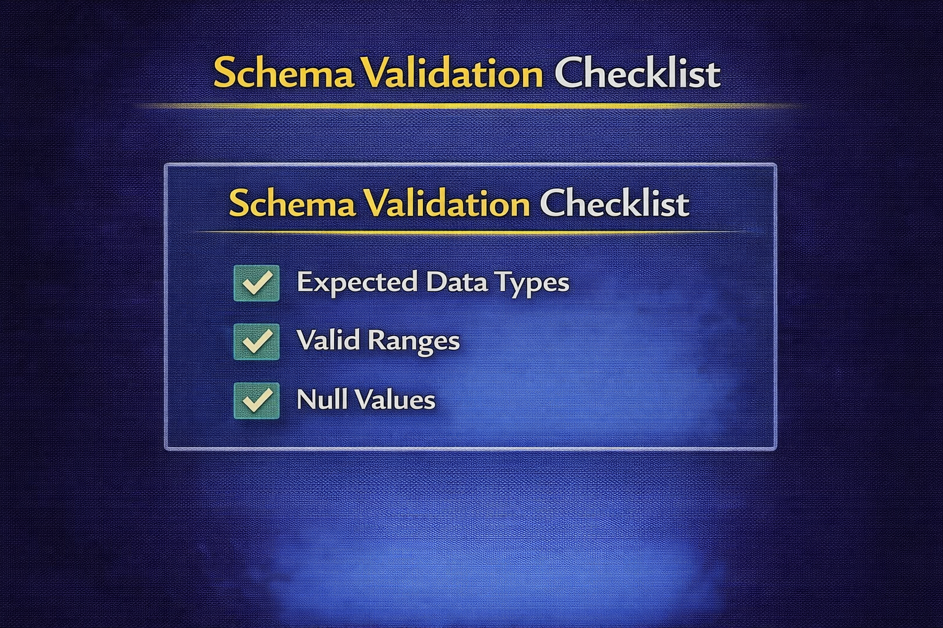
DAY 9 · DATA TYPES
Datetime Parsing
pd.to_datetime(errors='coerce') for varied formats
Benefits
Follow-Up
• Single datetime64 dtype enables time features
• Invalid entries become NaT (not errors)
• Can infer format automatically
• Decide how to handle NaT (drop or impute)
• Extract useful features (year, month, day)
• Watch for timezone issues
DATETIME CONVERSION
df_dates = pd.DataFrame({
"signup_date": ["2024-01-01", "01/03/2024", "2024/01/05", "2024-13-01", None]})
df_dates["signup_dt"] = pd.to_datetime(df_dates["signup_date"], errors="coerce")
print(df_dates) # "2024-13-01" becomes NaT (invalid month)

Slide 39
DAY 9 · DATA TYPES
Feature Extraction from Dates
Consistent generation in training and production
Common Derived Features
Stability Requirement
• Year, month, day of week
• Days since signup or last event
• Quarter, weekend flag
• Time since reference date
Feature-generation function must be identical in offline training and online inference
Different logic = different features = broken model
DATE FEATURE EXTRACTION
ref = pd.to_datetime("2024-01-10")
df_dates["year"] = df_dates["signup_dt"].dt.year
df_dates["month"] = df_dates["signup_dt"].dt.month
df_dates["dayofweek"] = df_dates["signup_dt"].dt.dayofweek
df_dates["days_since_signup"] = (ref - df_dates["signup_dt"]).dt.days

Slide 40
DAY 9 · ACTIVITY & ASSESSMENT
Data Types Practice
Build production-ready schema normalizer
Activity
Assessment
1. Take CSV where all columns are 'object'
2. Identify: numeric-like, currency-like, datetime-like, mixed-type columns
3. Write conversion functions for each category
4. Apply to produce typed feature table
5. Validate all conversions (check NaN counts)
Explain how a type mismatch between training and production could cause a silent accuracy drop in a recommendation system.
Implement and document a normalize_schema(df) you would trust in production ETL.
SKELETON
def normalize_schema(df):
num_cols = ["age", "income"]
for c in num_cols: df[c] = pd.to_numeric(df[c], errors="coerce")
return df

